Slide 1



DEPARTMENT OF COMPUTER SCIENCE & ENGINEERING
SCHOOL OF COMPUTING
10214CS602 MINOR PROJECT -2 INDUSTRY PROJECTS
WINTER SEMESTER(2023-2024)
INITIAL REVIEW
“X-Ray Analysis of Palm and Fingers for Fracture Detection ”
SUPERVISED BY
PRESENTED BY
Dr. M. Saravana Karthikeyan B.Tech., M.E., M.B.A., Ph. D.,
Assistant professor - SENIOR GRADE
1. BOJJA.YASWANTHKUMARREDDY (VTU23983)(21UEID0500)
2. VIPRAPATANAM.VENKATA RAO (VTU23998)(21UECS0750)
3. MUNDRU SAI SANDEEP (VTU24052)(21UEID0502)

Slide 2
PROJECT TITLE JUSTIFICATION
Relevance to Healthcare: Fractures in the palm and fingers are common injuries that require accurate diagnosis for appropriate treatment planning. By emphasizing the use of X-ray analysis, the title highlights the medical imaging technique central to the project's objectives. This emphasis underscores the project's relevance and potential impact on healthcare practices related to orthopedic medicine.
Highlighting Technological Approach: The inclusion of "X-Ray Analysis" in the title signals the technological approach being employed in the project. It indicates that the project involves the use of advanced imaging technology and analysis methods, which may include image processing, machine learning, and computer vision techniques, to aid in fracture detection.
Focus on Detection: The phrase "Fracture Detection" underscores the primary goal of the project, which is to develop a system capable of identifying fractures within the palm and fingers. This highlights the project's contribution to improving diagnostic capabilities in the field of orthopedic medicine, potentially leading to more timely and accurate identification of fractures.
Conciseness and Readability: The title is concise yet descriptive, making it easy to understand for both technical and non-technical audiences.

Slide 3
OBJECTIVE & SCOPE OF THE PROJECT
OBJECTIVE:
The objective of the project is to develop a system for fracture detection in the palm and fingers using X-ray analysis. This system aims to accurately identify fractures in the bones of the hand, providing medical professionals with a reliable tool for diagnosis and treatment planning.
Scope of the Project:
Image Acquisition: The project will involve acquiring X-ray images of the palms and fingers from patients with suspected fractures. This may include both conventional X-ray machines and digital radiography systems.
Image Preprocessing: Preprocessing techniques will be applied to enhance the quality of the X-ray images, including noise reduction, contrast adjustment, and image alignment.
Feature Extraction: Relevant features from the X-ray images will be extracted to identify potential fractures. This may involve detecting discontinuities in bone structures, analyzing bone density variations, and identifying abnormal bone shapes.

Slide 4
OBJECTIVE & SCOPE OF THE PROJECT
Scope of the Project:
Fracture Detection Algorithm: A fracture detection algorithm will be developed to analyze the extracted features and identify regions of interest indicating potential fractures. Machine learning techniques may be employed to train the algorithm using annotated X-ray images.
User Interface: A user-friendly interface will be designed to allow medical professionals to upload X-ray images, run the fracture detection algorithm, and view the results. The interface may include features such as image annotation tools and diagnostic reports generation.
Validation and Testing: The developed system will be rigorously tested using a dataset of X-ray images with known fracture cases. Performance metrics such as sensitivity, specificity, and accuracy will be evaluated to assess the system's reliability and effectiveness.
Integration with Existing Healthcare Systems: The final system will be designed to seamlessly integrate with existing healthcare infrastructure, allowing for easy adoption by medical facilities and practitioners.

Slide 5
TOOLS TO BE USED IN THE PROJECT
1. Flask: Flask is a micro web framework for Python used to develop web applications. It provides tools, libraries, and technologies to build web applications quickly and easily.
2. HTML Templates (render_template): Flask uses Jinja2 templating engine to render HTML templates. The `render_template` function is used to render HTML templates with dynamic content.
3. File Upload (request.files): The application allows users to upload files, particularly images in this case. Flask provides `request.files` to access uploaded files in the request object.
4. UUID (uuid): Universally Unique Identifiers (UUIDs) are used to generate unique filenames for uploaded files. The `uuid.uuid4()` function generates a random UUID.

Slide 6
TOOLS TO BE USED IN THE PROJECT
5. os: The `os` module provides a way to interact with the operating system. In this application, it's used to manipulate file paths and handle file operations like saving uploaded images.
6. Machine Learning Model (predictions.py): There is a separate module or file named `predictions.py`, which contains a function `predict()` responsible for making predictions. This function takes an image file path and a model name as input and returns the prediction result.
7. Error Handling: Exception handling is implemented to catch any errors that may occur during file processing or prediction. If an error occurs, an appropriate error message is displayed to the user.
8. Debug Mode (app.run(debug=True)): Flask's built-in development server runs in debug mode when `debug=True` is set. This enables features like automatic reloading of the application when code changes are detected and provides detailed error messages in case of exceptions.

Slide 7
SOCIETAL IMPORTANCE OF THE PROJECT
Improved Healthcare Access and Quality: By developing a reliable system for fracture detection in the palm and fingers using X-ray analysis, the project contributes to improving healthcare access and quality. Accurate and timely diagnosis of fractures is essential for appropriate treatment planning and patient outcomes.
Enhanced Patient Care and Safety: Fractures in the palm and fingers can have significant implications for patients' mobility, dexterity, and overall quality of life. Early detection and treatment of fractures are crucial for preventing complications and promoting optimal recovery.
Reduction of Healthcare Burden and Costs: Timely diagnosis of fractures can help reduce the burden on healthcare systems by minimizing the need for unnecessary procedures, hospitalizations, and prolonged treatments.
Empowerment of Healthcare Professionals: The project empowers healthcare professionals, including radiologists, orthopedic specialists, and primary care physicians, by providing them with advanced tools and technologies for fracture detection.

Slide 8
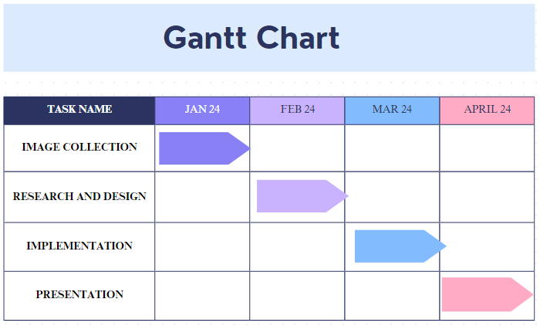
TIMELINE OF THE PROJECT

Slide 9

THANK YOU

